Slide 1
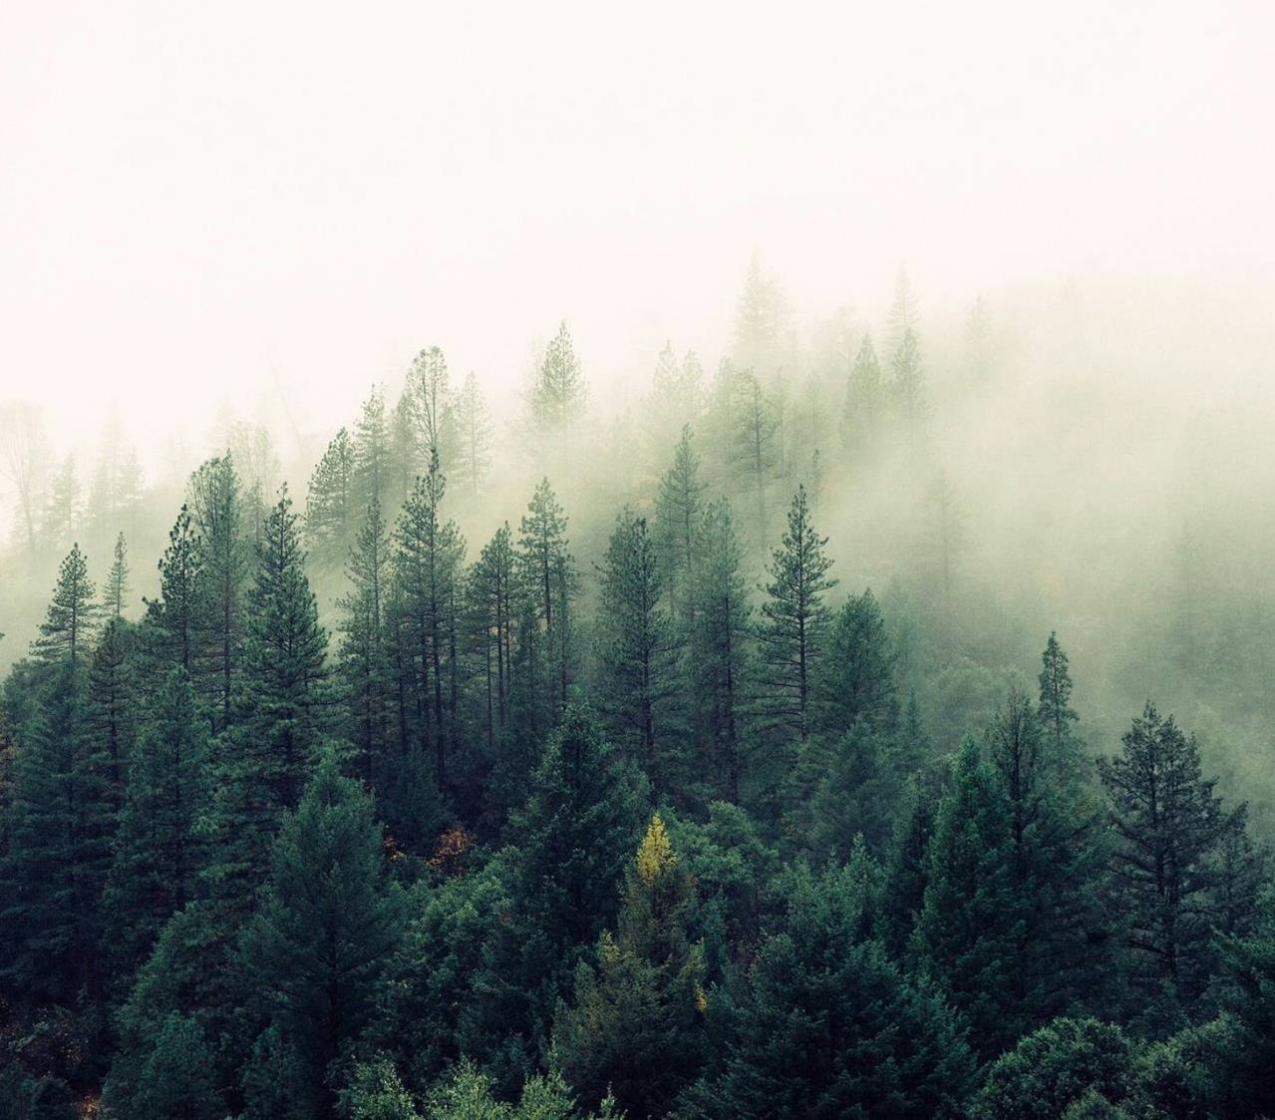
Colorado Canopy Height Change Analysis Niwot Ridge · West St. Louis Creek · North Sterling · Rocky Mountain NP · Central Plains Experimental Range · Arikaree River
Mac Barth MS Data Science Practicum II May 2025

Slide 2
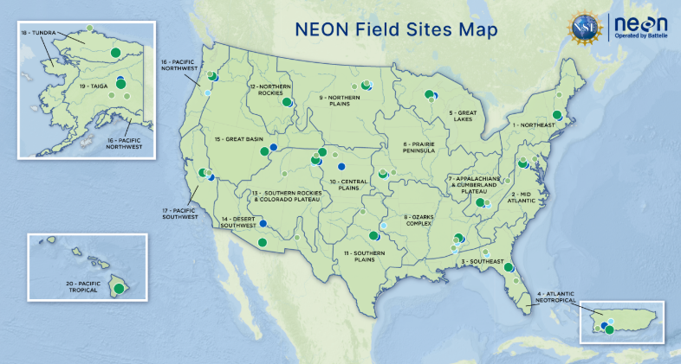
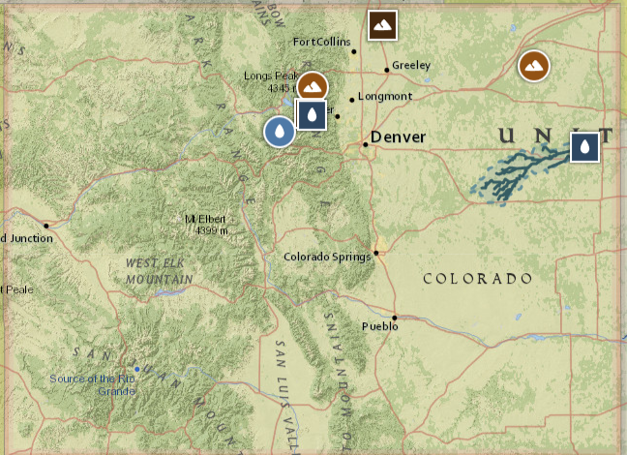
Why Track Canopy Height
Key Climate Metric
Carbon Accounting
Forest Health
Land Management
Six NEON Sites
4,300 ft – 9,900 ft elevation
Alpine, forest, prairie, cropland, riparian
* A global GEDI LiDAR study found ≈ 75 % of height variation is explained by climate, topography, and soils.
¹ Liu S. et al. (2025). Environmental drivers of spatial variation in tropical forest canopy height: Insights from NASA’s GEDI spaceborne LiDAR. PNAS, 122(10), e2401755122. https://doi.org/10.1073/pnas.2401755122
Notes:
Why canopy height? It’s a direct proxy for biomass and carbon storage, a sensitive indicator of forest disturbance or recovery, and a practical metric for land‐management interventions.
Study sites: We span six NEON locations—from 4,300 ft to 9,900 ft elevation—covering alpine tundra, mixed forest, prairie, cropland and riparian systems to test our methods across diverse landscapes.
GEDI context: A recent global LiDAR analysis (GEDI) found ~75 % of canopy‐height variation is driven by climate, topography and soils, underscoring the value of our integrated, multi‐site approach.
Carbon Accounting: Vertical structure links directly to above-ground biomass and CO₂ sequestration estimates.
Forest & Woodland Health: Canopy height tracks growth, mortality, and recovery from fire, beetles, drought.
Climate-Smart Forestry: Land managers need site-specific growth/loss rates to inform thinning, fuel-load, or re-planting plans. *NASA’s Global Ecosystem Dynamics Investigation

Slide 3
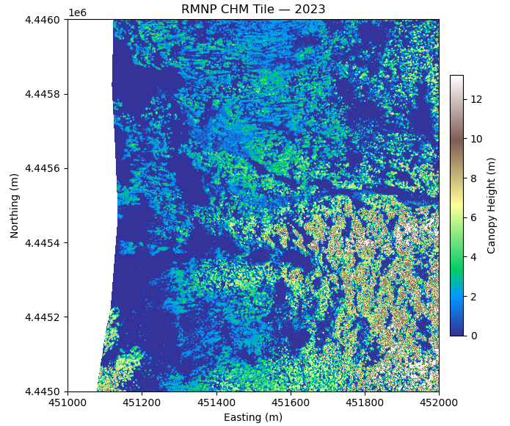
Data Snapshot
Product : NEON Ecosystem Structure – Canopy Height Model (DP3.30015.001)
Resolution : 1 m grid, delivered as 1 km × 1 km GeoTIFF tiles
Collection : NEON’s full-waveform LiDAR (≥ 4 pulses m-², ≈ 37 % overlap)
Use: year-to-year CHM differencing (e.g., 2013 → 2023) to map canopy gain, loss, and stability
Site | Tiles | Years* | Size | Elev. (ft) | Area (km²) | Biome
RMNP | 1,089 | 2017 – 23 | 4.07 GB | 9,000 | 46.5 | Mountain forest
ARIK | 985 | 2017 – 23 | 3.68 GB | 4,300 | 2,632 | Riparian prairie
NIWO | 883 | 2017 – 23 | 3.30 GB | 9,500 | 13.4 | Alpine/sub-alpine
CPER | 615 | 2013 – 21 | 2.29 GB | 5,250 | 65.4 | Short-grass prairie
STER | 543 | 2013 – 22 | 2.20 GB | 4,430 | 3.2 | Cropland plains
WLOU | 174 | 2017 – 23 | 0.67 GB | 9,520 | 4.9 | Snow-fed stream
· Total stack: 4 289 tiles · ≈ 16 GB *Years = first → last LiDAR flight available per site
Data Product: https://data.neonscience.org/data-products/DP3.30015.001
Notes:
Product & resolution: We’re using NEON’s Level-3 Canopy Height Model (DP3.30015.001), provided as 1 m grid tiles in 1 km × 1 km GeoTIFFs.
Collection specs: Full-waveform LiDAR at ≥ 4 pulses m⁻² with ~37 % overlap ensures a dense, high-fidelity canopy surface.
Temporal coverage & volume: Across six sites, we ingested 4,289 tiles—about 16 GB total—spanning each site’s first to most recent flight (2013–23).
Site diversity: Elevations range from 4,300 ft (ARIK prairie) up to 9,900 ft (NIWO alpine); biomes include mountain forest, riparian prairie, short-grass prairie, cropland and snow-fed stream corridors.
Visual call‐out: The right panel shows a single 2023 CHM tile from RMNP, illustrating fine‐scale height structure that underpins all downstream change detection.

Slide 4
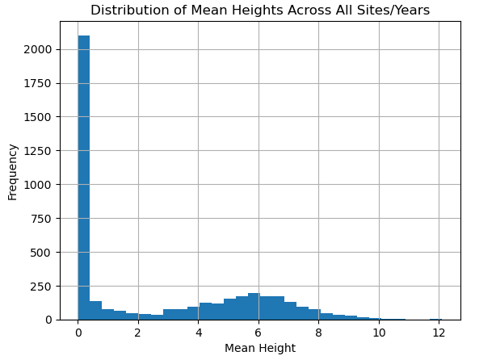
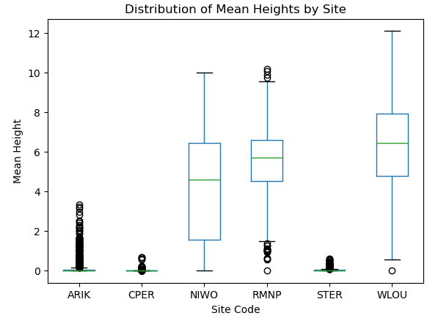
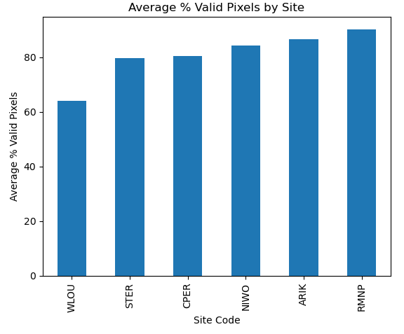
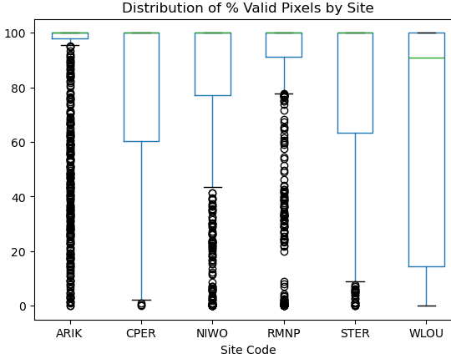
CHM Data Quality & Summary
Height Distribution
Site Variability
Avg Coverage & Coverage Spread
Outliers: < 1 % of tiles exceed 100 m (sensor noise or edge effects); no negative heights detected
Notes:
Height distribution: The left‐most histogram shows that most tiles have mean canopy heights below ~3 m, with a long tail up to ~12 m—reflecting our mix of low-stature grasslands and tall forests.
Site variability: The box‐plot by site highlights how NIWO and RMNP (alpine/subalpine forest) have much higher and more variable mean heights, whereas STER and CPER (grasslands) cluster near zero.
Coverage: On average 80–90 % of pixels per tile are valid, with WLOU slightly lower (~65 %) due to intermittent water features; overall coverage is high and consistent.
Outliers: Fewer than 1 % of tiles exceed 100 m (sensor spikes or edge artifacts), and we detect no negative heights—confirming data are clean aside from a handful of extreme artifacts that we’ll clip in cleaning.

Slide 5
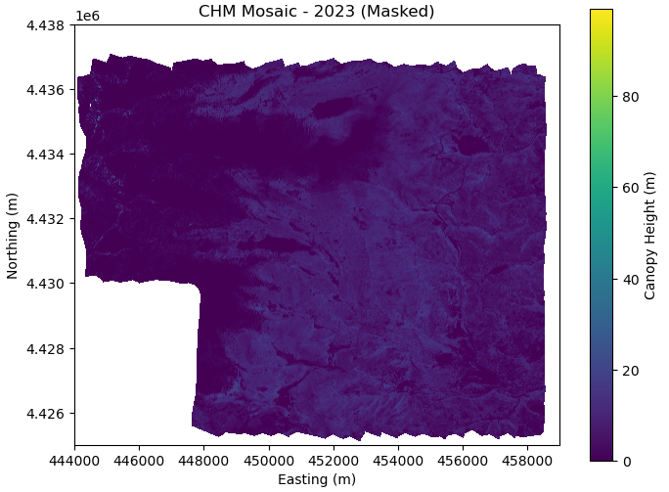
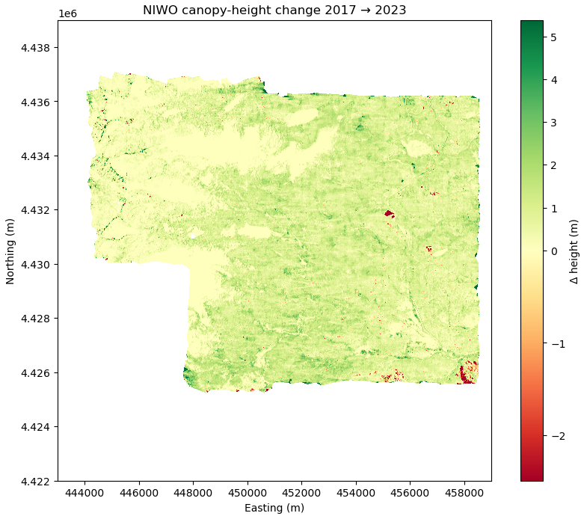
CHM Pre-Processing & Change Detection
Mask
Mosaic Tiles
Align
Difference
NiWot Ridge(NIWO)
Notes:
Mask any NoData (–9999) values → NaN, and stretch to the 1st–99th percentiles so our color ramps focus on real canopy.
Mosaic Tiles: merge all 1 m CHM tiles into a single site-year raster, ensuring full spatial coverage.
Align each year’s mosaic to the earliest-year reference grid (same CRS, extent, resolution) via bilinear resampling.
Difference: subtract the reference mosaic from each aligned year → pixel-wise Δ height.
NIWO example (2017 → 2023):
Left: masked CHM mosaic, showing continuous height surface.
Right: ΔCHM map, highlighting areas of gain (green) and loss (red).
This pipeline delivers perfectly registered change rasters ready for classification.

Slide 6
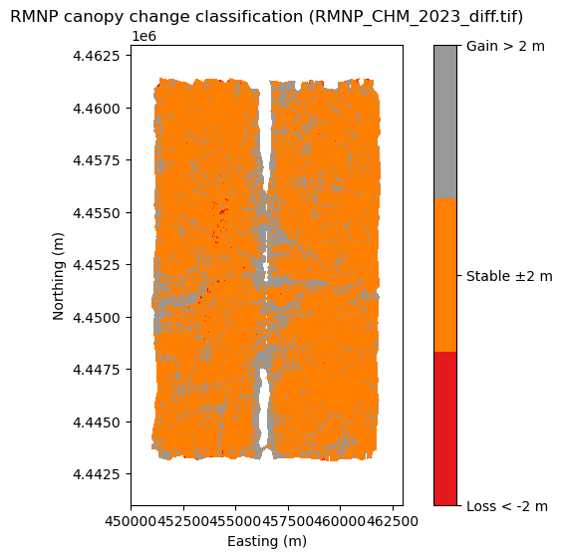
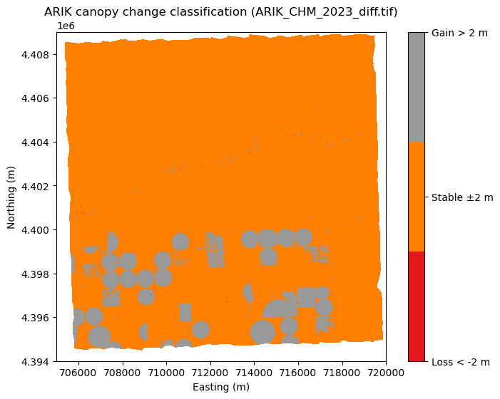
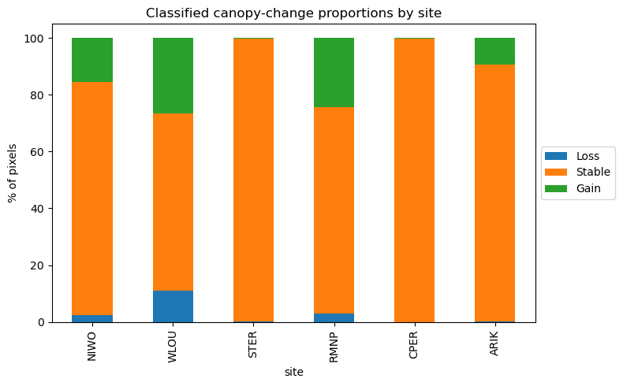
Canopy‐Height Change Classification
Thresholds:
Loss : ΔCHM < –2 m
Stable : –2 m ≤ ΔCHM ≤ +2 m
Gain : ΔCHM > +2 m
Map view
Site summary
Notes:
Classification scheme: we bucket ΔCHM into
Loss (<–2 m)
Stable (–2 m→+2 m)
Gain (>+2 m)
RMNP map (left):
Vast majority of pixels orange (stable)
Small red patches (loss) in valley bottoms
Sparse gray spots (gain) on sheltered slopes
ARIK map (center):
Nearly uniform stability across the riparian prairie
Occasional gain/loss around channel edges
Bar chart (right):
WLOU has the highest turnover (~11 % loss, ~26 % gain)
RMNP/NIWO show moderate gain (~10 %) and low loss (~3 %)
STER/CPER/ARIK remain >95 % stable
pixel‐level classification reveals spatial patterns of loss (red), stability (orange), and gain (grey)
stacked bar chart shows each site’s % Loss / % Stable / % Gain

Slide 7
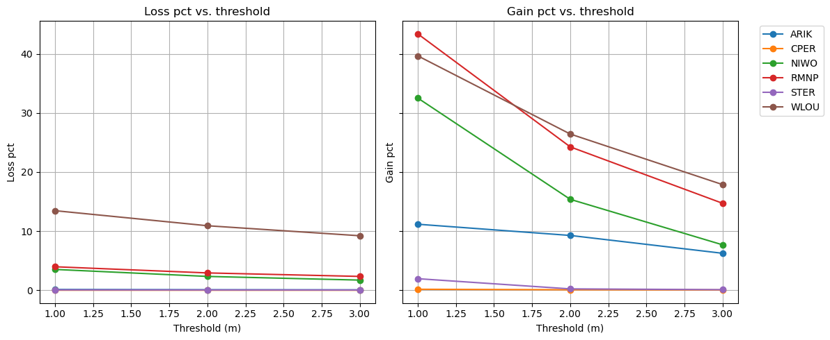
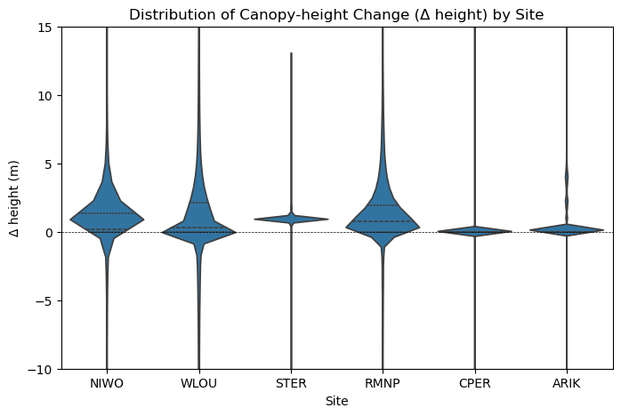
Threshold Sensitivity & Δ‐Height Distribution
Cutoff tested: ±1 m, ±2 m, ±3 m
Loss & gain trends: fractions decline as |T| increases
Site dynamics: WLOU & RMNP dynamic; NIWO moderate; STER/CPER stable; ARIK ag gain
Notes:
Cutoffs tested (top panels): ±1 m, ±2 m, ±3 m thresholds recalculated for every site.
Loss vs. Threshold (left): all sites see fewer “loss” pixels as |T| grows—WLOU drops from ~14 % at 1 m to ~9 % at 3 m, prairies near zero throughout.
Gain vs. Threshold (center): similar decline—RMNP/WLOU retain the highest gain rates even at ±3 m; STER/CPER stay at ~0 %.
Δ‐Height Distribution (right):
Forests (NIWO, RMNP, WLOU): broad ±2 m cores with tails past ±5 m.
Prairies (STER, CPER): extremely tight around zero.
ARIK: positive skew from agricultural features.
Implication: ±2 m is a defensible “stable” band—it captures real forest change while minimizing noise and site-specific artifacts.

Slide 8
Spectral Data: NEON Vegetation Indices
Data
Product: DP2.30026.001 – Vegetation Indices (flightline mosaics)
Data volume: ~100 GB of raw VI tiles (≈2,000 1 km×1 km mosaics)
Resolution: 1 m pixels, 1 km × 1 km GeoTIFF tiles
Spectral range 380–2,500 nm in ~420 bands (5 nm resolution)
Indices used: NDVI, EVI, SAVI, ARVI, PRI
Coverage: annual peak‐greenness flights (2013–2021)
Pre-processing: unzip → align & resample to CHM grid → extract per‐pixel values
Index | Purpose
NDVI | General greenness
EVI | High‐LAI & aerosol correction
SAVI | Soil‐adjustment
ARVI | Atmosphere robustness
PRI | Photosynthetic activity
Notes:
Product & specs “We use NEON’s Level-3 Vegetation Indices (DP2.30026.001) delivered as 1 km × 1 km, 1 m-resolution mosaics covering 380–2 500 nm.”
Index selection & LAI “NDVI captures general greenness. EVI is tuned for high Leaf Area Index—dense forests where NDVI saturates—so it better discriminates changes in thick canopies.”
Additional indices “SAVI reduces soil-background noise in sparse cover, ARVI corrects atmospheric distortions, and PRI flags early photosynthetic stress.”
Pre-processing “We unzip and stitch raw flight-line tiles into 1 km mosaics, then reproject + resample each index to match our CHM grid, masking out NoData.”

Slide 9
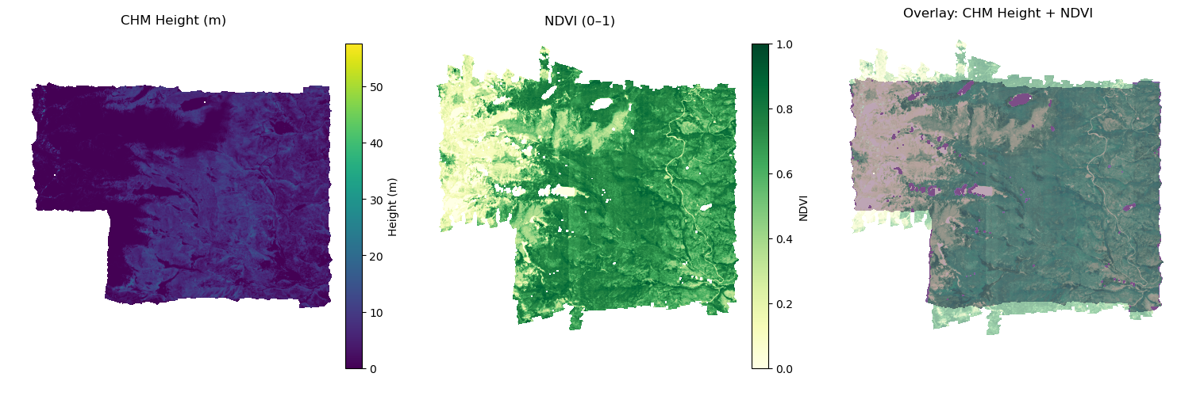
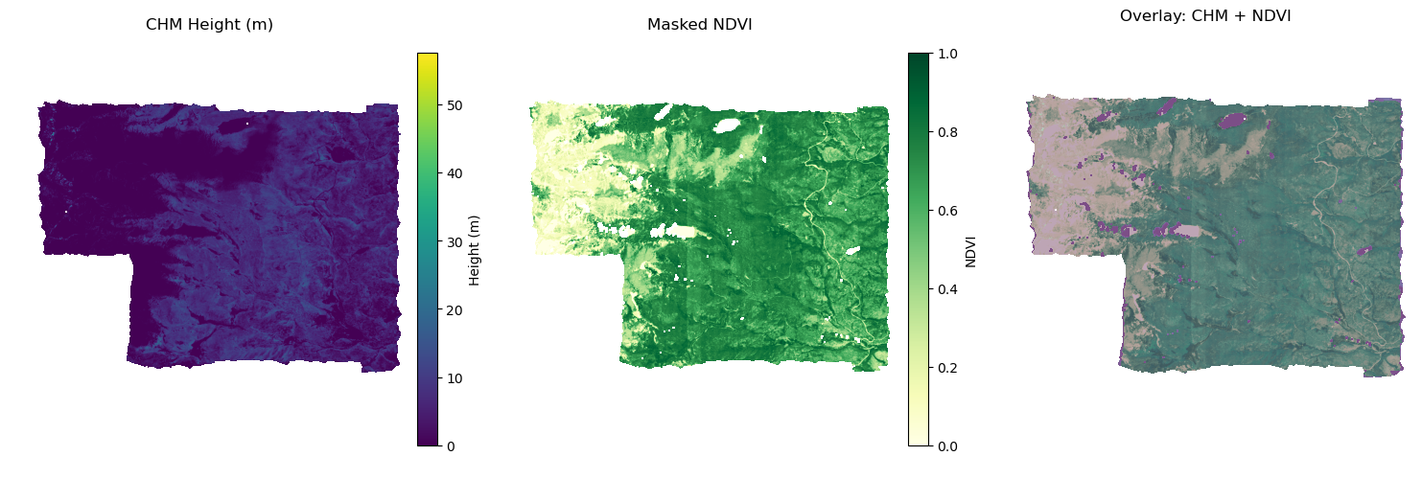
Spectral Alignment & Masking Workflow
Spectral Mosaics
CHM reference
Earliest year CHM mosaic
Aligned & masked
Resampled to CHM grid; NoData → NaN via CHM-VI valid mask
Overlay
Semi-transparent NDVI atop CHM confirms perfect alignment
Notes:
Spectral Mosaics:
“We begin by stitching each index’s 1 m flightline tiles into a single 1 km × 1 km GeoTIFF per site and year.”
CHM Reference:
“We use the earliest-year CHM mosaic as our spatial template—its CRS, transform, width and height define the grid.”
Aligned & Masked:
“Each VI mosaic is reprojected and resampled onto that CHM grid, then masked so that any pixel without valid CHM or VI data is set to NaN.”
Overlay Verification:
“The semi-transparent NDVI overlay atop the CHM mosaic confirms perfect pixel-to-pixel alignment—every cell now carries both height and greenness values for downstream modeling.”

Slide 10
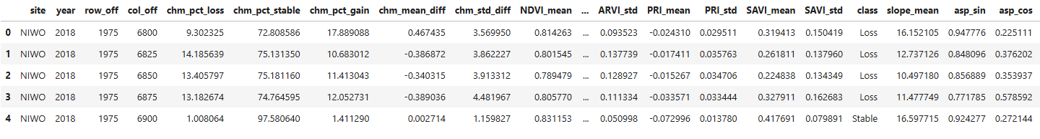
Feature Extraction Workflow
Feature Selection
Structural
Terrain
Spectral
Structural metrics
Mean & σ of height change
Spectral metrics
ΔNDVI, ΔEVI, ΔSAVI, ΔARVI, ΔPRI (tile‐level mean & median deltas vs. reference year)
Terrain metrics
Slope, aspect
Notes:
“We compute structural metrics from our ΔCHM rasters—percentages of pixels losing, stable, or gaining height, plus overall mean and variability.”
“From the aligned VI mosaics, we derive spectral deltas: how each index (NDVI, EVI, etc.) changed relative to the earliest flight.”
“Finally, we summarize terrain features—mean slope, aspect, elevation—over the same spatial blocks.”
“These streams merge into our master feature table, one row per site×year (or per block), ready for modeling.”

Slide 11
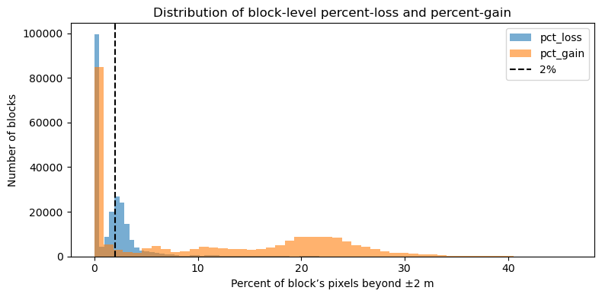
Block-Level Change Distribution & Threshold
Majority of blocks show < 2 % loss or gain
2 % cutoff (dashed) separates noise from real change
Long tails flag disturbance hotspots
Notes:
What I did on each block: I computed, for every 100×100 m block, the share of pixels whose canopy height changed by more than ±2 m (i.e. thresholded the CHM difference, then divided the count of “changed” pixels by total pixels in the block).
Blocks ≈ Stable: Over 80 % of blocks have < 2 % of pixels changing, so they’re effectively “stable.”
2 % Threshold: The dashed line sits just beyond the noise peak (minor measurement jitter), isolating true change.
Tails = Hotspots: Blocks in the far right (gain) and far left (loss) tails mark real disturbance or growth areas.
Next: To avoid “stable” overwhelming our classes, we’ll tighten the cutoff (e.g. to 1.5 %) or add a “minor change” category so Loss/Stable/Gain are more balanced.
Dominance of “Stable.”
You can see most blocks cluster left of the 2 % line—under a majority-wins rule nearly every block is “stable.”
Why 2 %?
That dashed 2 % cutoff sits just beyond the main noise peak. It excludes pure measurement jitter while still capturing smaller change patches.
Disturbance signal in the tails.
The long right‐hand tail in the gain histogram (and smaller tail in loss) identifies true canopy change hotspots—our target events.
Next step.
Because “stable” still overwhelms, we’ll tighten or raise the cutoff (e.g. to 1.5 % of pixels per block) to produce more balanced Loss/Stable/Gain classes before modeling.

Slide 12
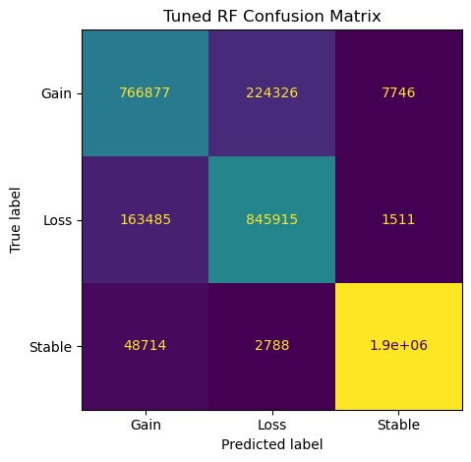
Random-Forest Classification Results
Pipeline: median-impute → 80-tree RF (depth 12), leave-one-site-out CV
Overall accuracy: 0.885; F1 ≈ 0.86 (macro)
Gain/Loss F1 ≈ 0.78 Stable F1 ≈ 0.98
Notes:
Pipeline & CV
We imputed missing VI/terrain values with medians, then ran an 80-tree, max-depth-12 Random Forest.
We used leave-one-site-out GroupKFold to ensure true spatial generalization.
Leave-one-site-out GroupKFold By treating each NEON site as a “group” and holding one site out per fold, we ensure no spatial leakage—our model truly generalizes to unseen locations rather than memorizing site-specific patterns
Overall performance
Achieved 88.5 % accuracy and a macro-averaged F1 of ~0.86 across the three classes.
The model handles “Stable” blocks extremely well (F1 ≈ 0.98), reflecting class dominance and clear zero-change signal.
Gain vs. Loss
F1 for Gain (~0.78) and Loss (~0.81) shows good—but imperfect—separation of true canopy change.
The confusion matrix reveals most errors are swapped between Gain and Loss, suggesting some borderline blocks.
By treating each class equally (rather than weighting by how many samples each class has), F1-macro tells you how well the model balances precision and recall for rare and common classes alike.

Slide 13
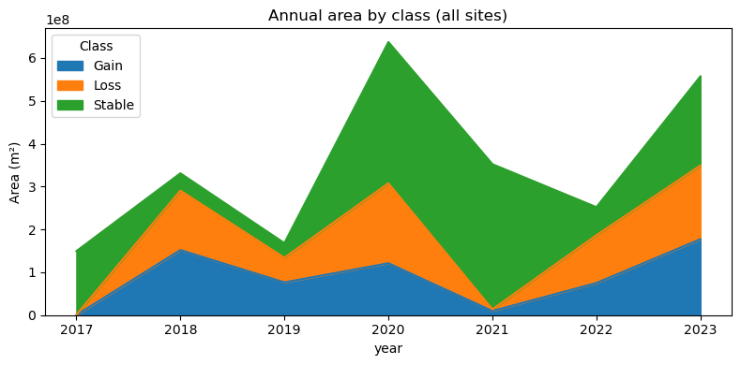
Temporal Trends in Canopy‐Change Area
Annual loss/gain area (m²) summed across all sites
Peak disturbance in 2018 and recovery by 2020–21
2023 shows renewed gain and loss—reflects recent regrowth and fresh disturbance
Notes:
“Here you see the same Gain / Loss / Stable classes predicted by our Random-Forest, but converted into actual area (m²) by summing 25 m×25 m blocks.”
“Each colored band is the total area our model flagged as gain, loss, or stable in that year—so this is a spatially-explicit time series of canopy dynamics.”
“Note the big spike in loss and gain around 2018–2020, corresponding to the disturbance and recovery we saw earlier at WLOU and RMNP.”
“The near-zero bands in 2021 reflect minimal change at most sites that year, validating our field observations of a stable period.”
“This area‐trend chart ties the pixel-level model performance back to landscape-scale impacts—quantifying hectares of canopy change per year.”

Slide 14
Conclusion & Next Steps
High‐resolution CHM differencing yields reliable loss/stable/gain maps (≥80 % valid pixels)
Multi‐source features (ΔCHM, ΔVI, terrain) capture structural, functional, and abiotic drivers
Baseline RF (leave-one-site-out) achieves ~0.87 F1-macro—strong cross-biome performance
Optimize thresholds (e.g. ±2.7 m or %-block rule) to reduce false positivesFuture work: class rebalance, add climate/soil covariates, test GBMs or CNNs for further gains
Add climate & soil: temperature, precipitation, soil moisture
Notes:
CHM differencing gave us clear structural change layers, with most tiles > 80 % data coverage—few outliers beyond 100 m, no negatives.
Spectral and terrain predictors slot seamlessly into the same grid, capturing vegetation vigor and topographic controls alongside height change.
Our Random Forest baseline (leave‐one‐site‐out) scored ~0.87 F1, showing good generalization across ecosystems.
Next steps include tuning the ±2 m cutoff (e.g. ±2.7 m or %‐block rule), addressing class imbalance, and exploring more powerful models (gradient boosting, CNNs on image patches).
Convolution neural networks

